Slide 1
Neural Networks
Bijoy Singh (120050087)
Sai Kiran Mudulkar(120050068)
Manik Dhar(120050006)

Slide 2
Lab Question
1. Let M be the number of distinct graphemes. Allocate ceiling(logM) bits for each grapheme. 2. Let N be the number of distinct phonemes. Allocate ceiling(logN) bits for each phoneme. 3. Your training data has EQUAL no. of graphemes and phonemes on either side of each item of the parallel corpus. 4. If L is the length of the grapheme sequence (correspondingly phoneme sequence), concatenate L bit vectors to form the G-P training data; If the size of the parallel corpus is K, you will have K vectors, each of size ML on the grapheme side, and of size NL on the phoneme side. 5. The G-to-P feed forward n/w will have an i/p layer of size ML, and o/p layer of size NL; similarly for P-to-G. 6. You will have to find by TRIAL AND ERROR the appropriate size of the hidden layer. Normally one hidden layer is fine, but the number of neurons in it has to be determined. Start with, say, average of ML and NL. 7. Do the usual 5-fold cross validation. Observe accuracy.

Slide 3
Perceptron Model
We implemented the perceptron model in the general form.
𝛉 was a part of the weights with constant input of -1
Both the models for deciding the value of the output were allowed(step threshold and sigmoidal threshold)
Also we made the schema general enough to use directly as well in a Neural Network

Slide 4
Perceptron Training
Perceptron training for problems just one perceptron uses the PTA algorithm.
It takes a truth table modifies it to create appropriate classes and inverts 0 class.
It now trains using the PTA algorithm which is guaranteed to converge if the function is separable.

Slide 5
Perceptron Performance
A perceptron can solve the problems as one would expect:
AND
OR
MAJORITY
but cannot to
PALINDROME (if it could it would be able to solve XOR, which we know it cannot)
XOR

Slide 6
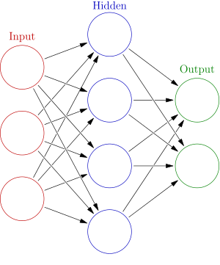
Neural Networks
We now used our existing infrastructure of perceptrons and using the sigmoid threshold neuron model, we used the to make a neural network

Slide 7
Neural Network
The user can specify
The number of inputs, number of neurons on each row, the number of outputs, η(for Δw_{ij} ) and the accuracy anticipated.
This way the user can control the learning rate(through η) and the final result accuracy.

Slide 8
Neural Network Training
We use the standard back propagation algorithm with the parameters η and accuracy(ɛ).
For the smaller boolean circuits, we have trained the network until the ɛ becomes very small(0.1) this can be modified by the user
The algorithm stops when the training is complete

Slide 9
Neural Network Performance
The neural network was tested on the following circuits and it performed as expected
3 input PALINDROME
4 input PALINDROME
XOR
FULL ADDER

Slide 10
Visual Results of Neural Training
Now the results of these neural networks are a bit difficult to visualise from text. Hence we made a module to allow for UI output for the neurons
The outputs of the various neural networks are displayed

Slide 11
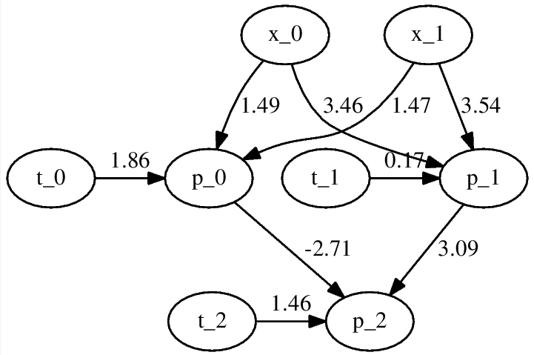
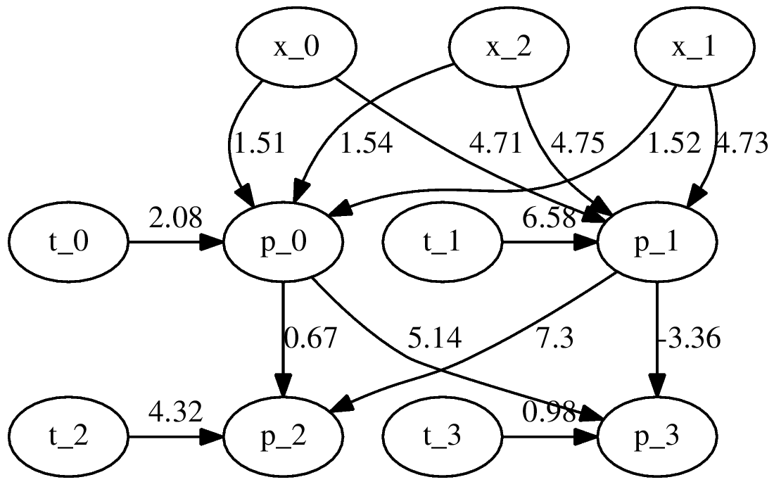
Visual Results of Neural Training
FULL ADDER
XOR

Slide 12
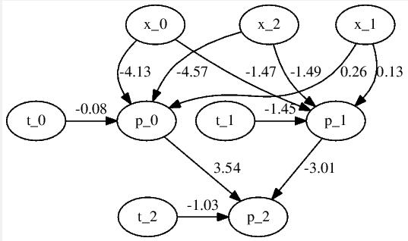
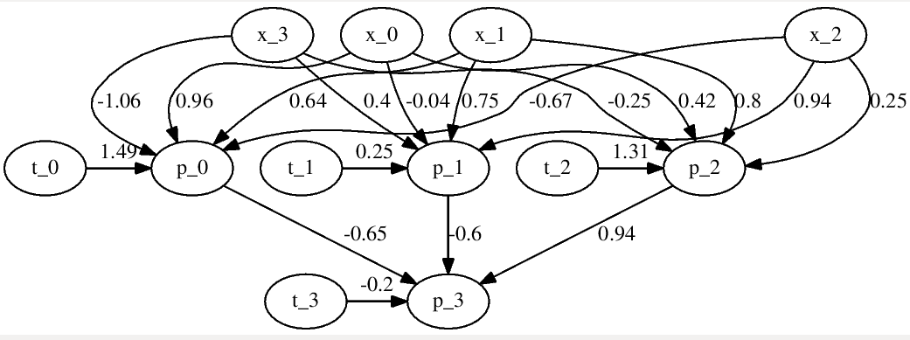
Visual Results of Neural Training
3 PALINDROME
4 PALINDROME

Slide 13
Grapheme To Phoneme using NN
We encoded the graphemes and phonemes using bit sequences by giving each grapheme and a phoneme a bit representation as given in the question
For padding we used 0000...
For testing we used this bit sequence

Slide 14
Training Adjustment
As the neural network is large we cannot expect it to train over the entire data till convergence(which is not even known if it will happen),
We iterate over a large cycles to let it train the data. The user can specify this using a command line argument

Slide 15
Neural Network Performance
The neural network performance is mixed* (we’ll analyse this later in this presentation and see why this answer isn’t the best measure what our system could achieve)
Measures to look at:
Word Length
Test Cases
Training Duration
Character Accuracy
Bit Accuracy

Slide 16
THE RESULTS
 | Test Case 1 | Test Case 2 | Test Case 3 | Test Case 4 | Tes
Test Case | Word Length 4 Test cases 10 | Word Length 4 Test cases 10 | Word Length 6 Test cases 100 | Word Length 8 Test cases 1000 | Word Length 10 Test cases 10000
Training Duration | 10000 iterations 1m 45.074s | 100000 iterations 9m40.104s | 20000 iterations ~10 hours | 20000 iterations 5 days 22hours!!!!! (Yes we actually ran that on a server for 6 days just to see what happens) | 1000 iterations 115m7.984s
Accuracy | 70.0% | 82.5% | 32.66% | 54.72% | 23.9986%
Word Efficiency | 97.1428% | 98.5714% | 83.11% | 89.6719% | 73.463%

Slide 17
Performance Issues and Improvements
The performance on smaller data being so high indicate that the mechanism has the potential of performing well,
However but as the amount of data becomes bigger, the amount of time to train(to the same level) increases exponentially.
Hence the increased requirement in time but reduced accuracy

Slide 18
How we can improve the accuracy
Increase the time to train (exponential)
Use more sparse numbering of the input grapheme bits
Dont use padding and work with only a standard size

Slide 19
Thank You

